Slide 1
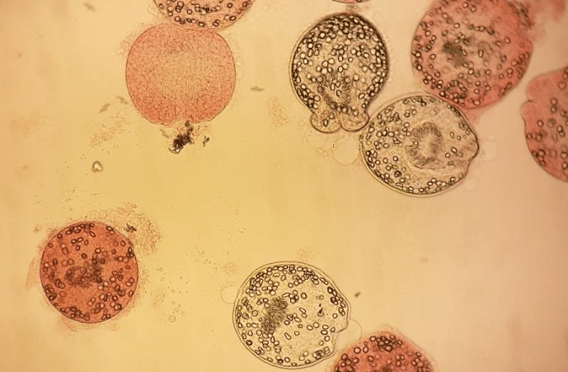

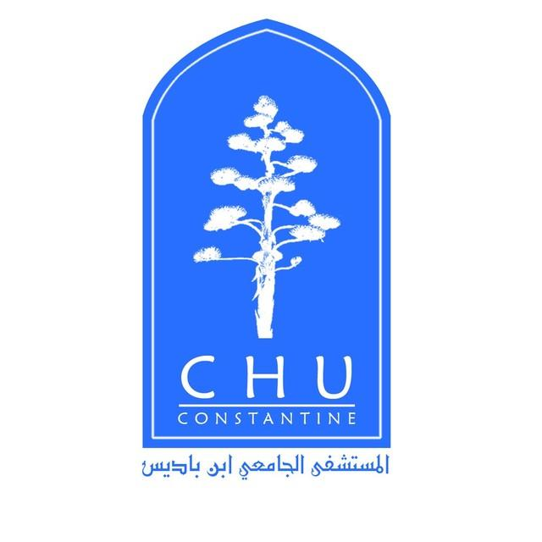
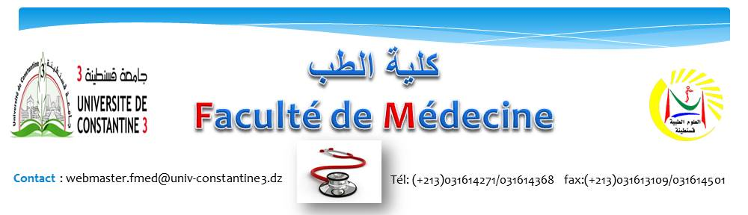
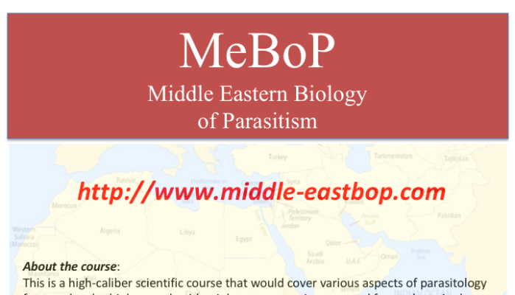
University Hospital Center of Constantine laboratory of medical parasitology-mycology University of Constantine 3
Middle Eastern Biology of Parasitism, University of Bern Switzerland, 23-05 August
Dr. Sofiane Mizi Allaoua
Resident pharmacist

Slide 2
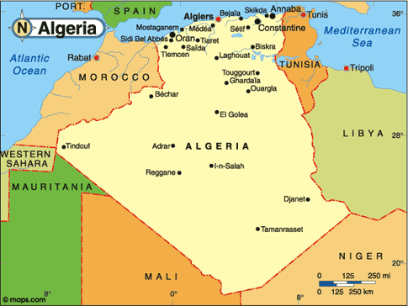
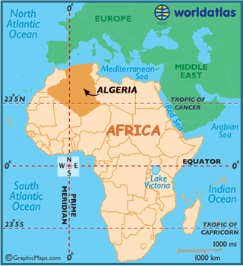
Location of Algeria in World
Notes:
Algeria is located in North Africa.it's the biggest country in Africa.
It is bordered to the north by the Mediterranean Sea, to the east by Tunisia and Libya, to the south by Niger, Mali and Mauritania to the west by Morocco and Western Sahara

Slide 3
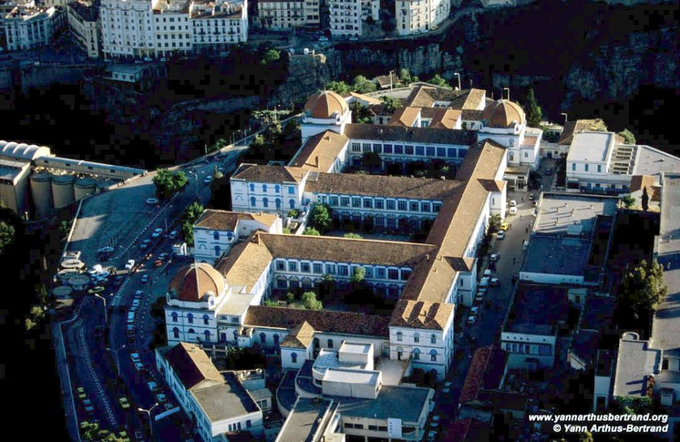
University Hospital center of Constantine
Laboratory of parasitology-mycology
Notes:
I am currently in training as fourth year resident pharmacist at parasitology-mycology laboratory of the university hospital center of Constantine

Slide 4
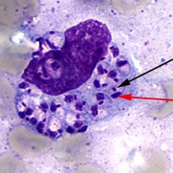
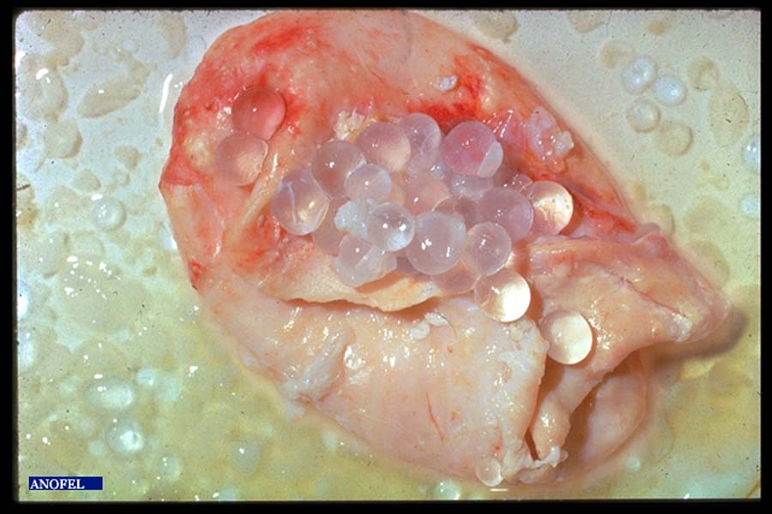
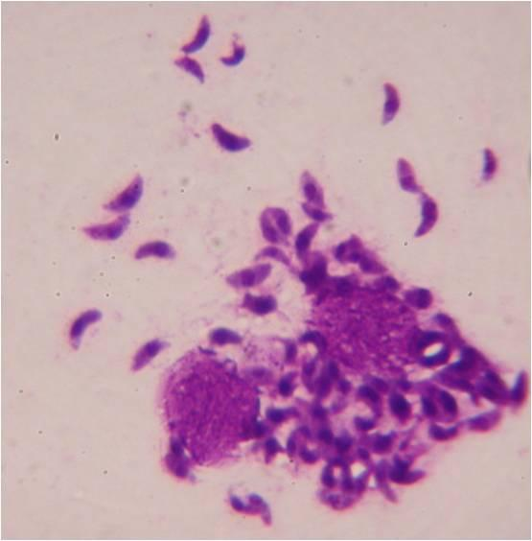
Presentation of the laboratory
The Laboratory performs three main functions: research, teaching, and hospital diagnosis in Parasitology-Mycology
The team work is composed of many professors, Assistant professors, residents and many technicians
Conduct and support research into the epidemiology, diagnosis, treatment, and prevention of infectious diseases particularly those are endemic in Algeria
Leishmaniasis
Hydatidosis
Toxoplasmosis

Slide 5
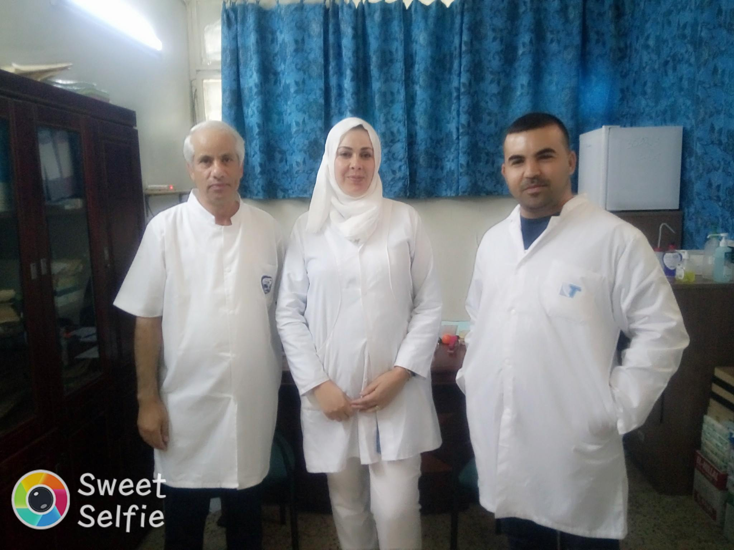
Pr T.Moulahem and Dr I.Aissaoui
Notes:
Personally I was interested in hydatid disease and I am working in a project with professor Moulahem (The head of the laboratory) and the assistant professor Aissaoui

Slide 6
the project's objectives
1
2
Epidemiological study on the hydatid cyst in children in eastern Algeria
scolicidal effects of some natural drugs in vitro

Slide 7
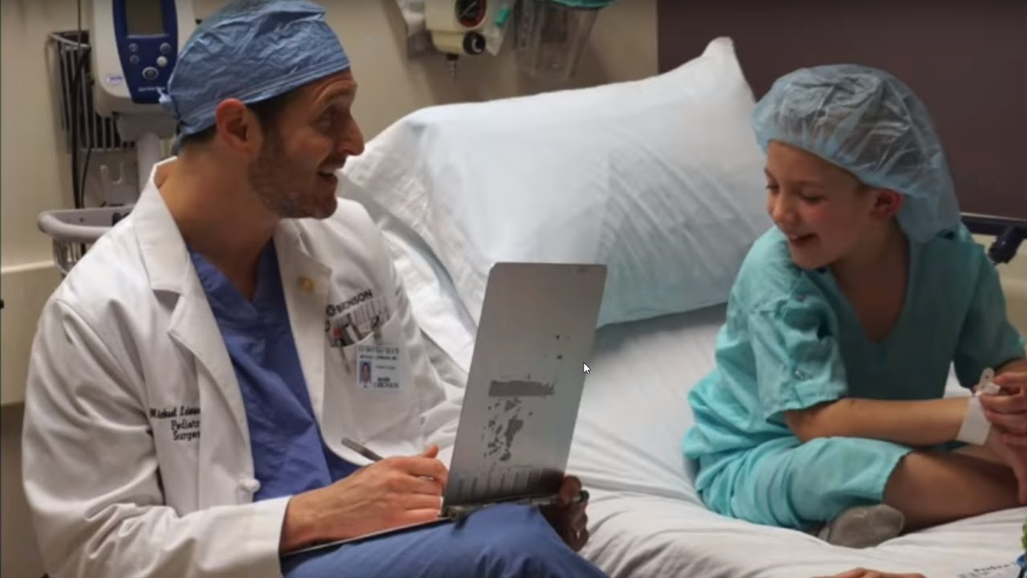
1. Epidemiological study on the hydatid cyst in children in eastern Algeria, in collaboration with the pediatric surgery department
Notes:
the first study was conducted in collaboration

Slide 8

The main objectives of this study is:
to clarify the epidemiological aspects of this disease and to compare it with other national and international studies.
The fertility rate of hydatid cysts.
The viability of protoscoleces.
Notes:
Calculate

Slide 9
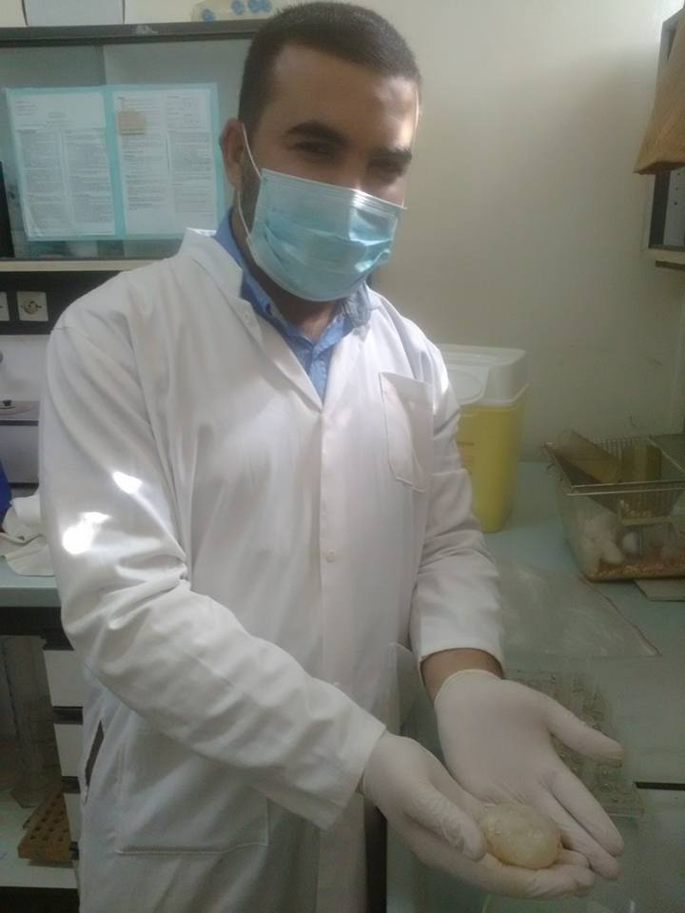
Reception of hydatic cysts from pediatric surgery
Notes:
When we receive the cyst from pediatric surgery we confirms that it is a hydatid cyst and we collect the protoscoleces

Slide 10
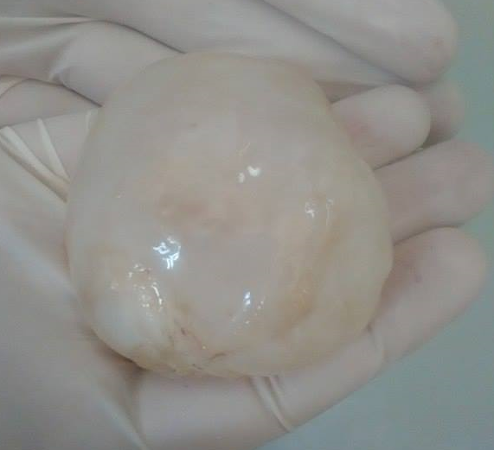
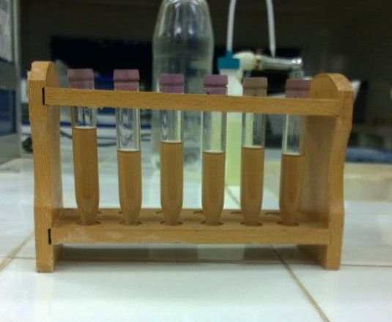
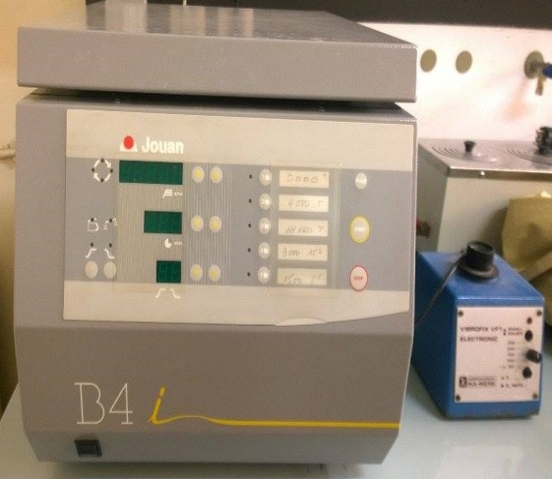
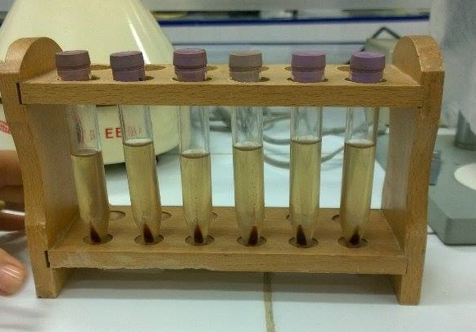
Collection of protoscoleces
Notes:
1.The hydatid liquid is transferred aseptically into glass tubes and then decanted for 30 min.
2.After removal of the supernatant, the protoscoleces were washed three times with normal saline solution

Slide 11
Direct examination under a light microscope
Presence of protoscoleces= fertile cyst
Notes:
The presence of protoscoleces means that the cyst was fertile

Slide 12
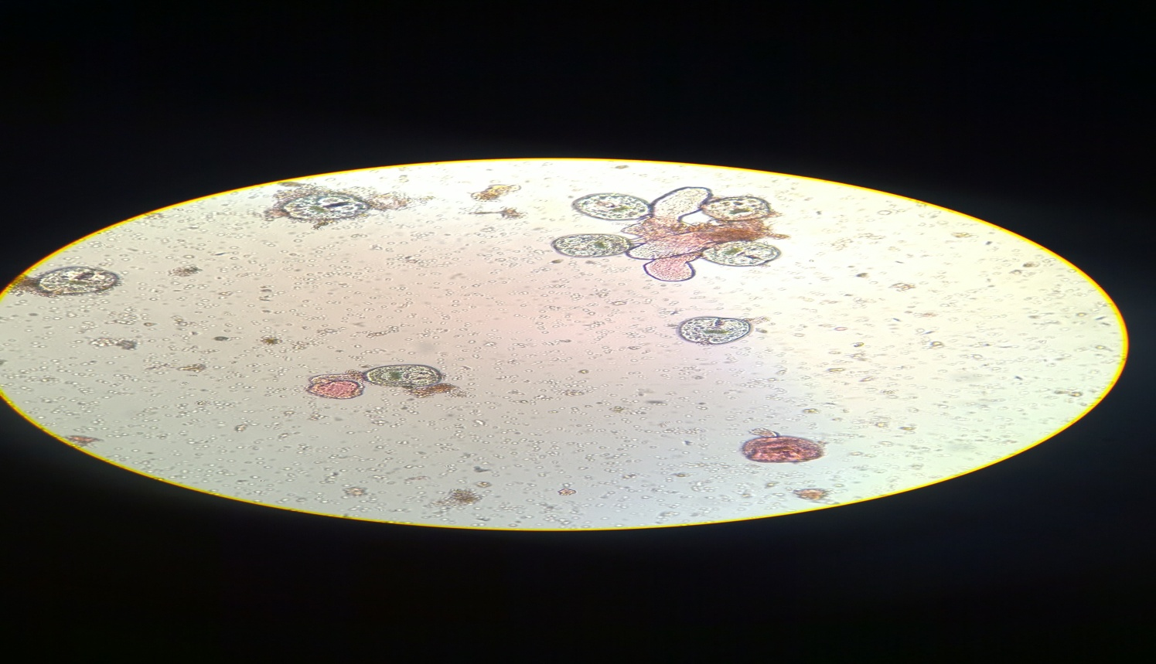
Viability test
Incoloured
protoscoleces: Viable
Coloured protoscoleces: Dead
Notes:
we checked the viability of protoscoleces using eosin stain with the concentration 0.1%
The viable protoscolices were stored at 4 celsius degre for further use

Slide 13

The lung is the most affected organ (45%), followed by the liver (33%)
The most affected age groups in our series range from 6 to 9 years and 11 to 14 years
83% of the cysts were fertile and the collected protoscoleces were viable
These results corroborate the results of other studies done in Algeria
(Zait H, et al.. 2013)
(Zait H, et al.. 2014)
Notes:
This study show that
This high percentage of viability may explain the high rate of recurrence
These results corroborate the results of other studies done in Algeria And confirms the endemicity of hydatid cysts in Algeria

Slide 14
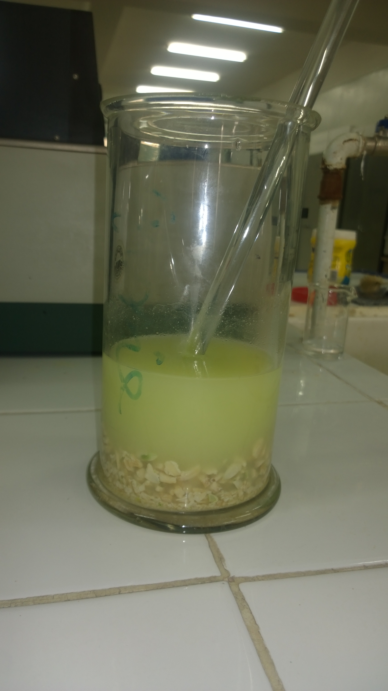
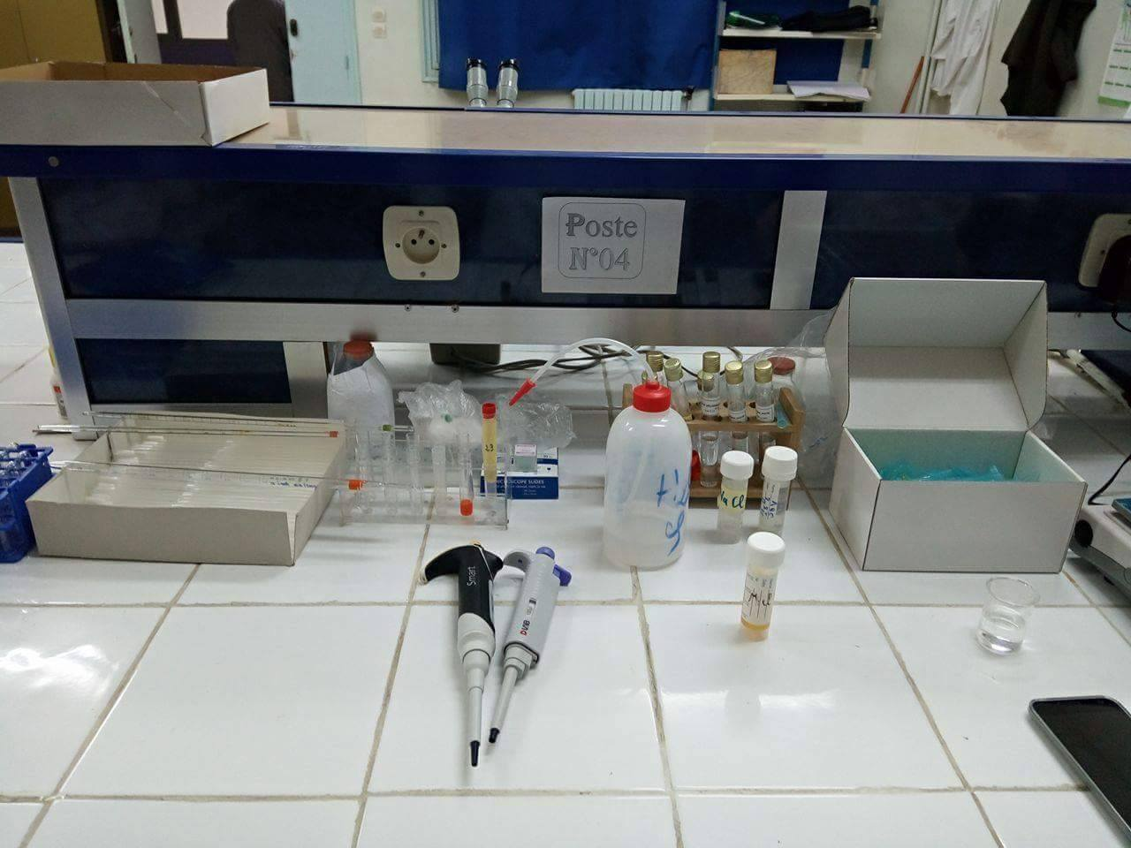
2. Evaluation of scolicidal activity of some drugs
1.Preparation of drug extracts laboratory of pharmacognosy
2.Test of the scolicidal effect of drugs extracts
Laboratory of parasitology
Notes:
We used the protoscoleces collected during the first study
The study is divided into two stages

Slide 15
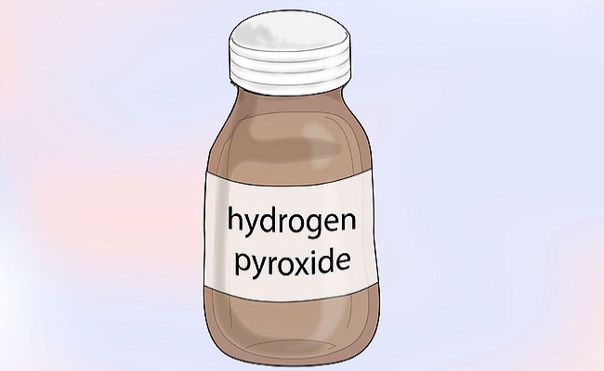

chemical agents
Find less harmful and more effective scolicidal solutions for use in hydatid cyst surgery
Notes:
Replace chemical agents with side effects by

Slide 16
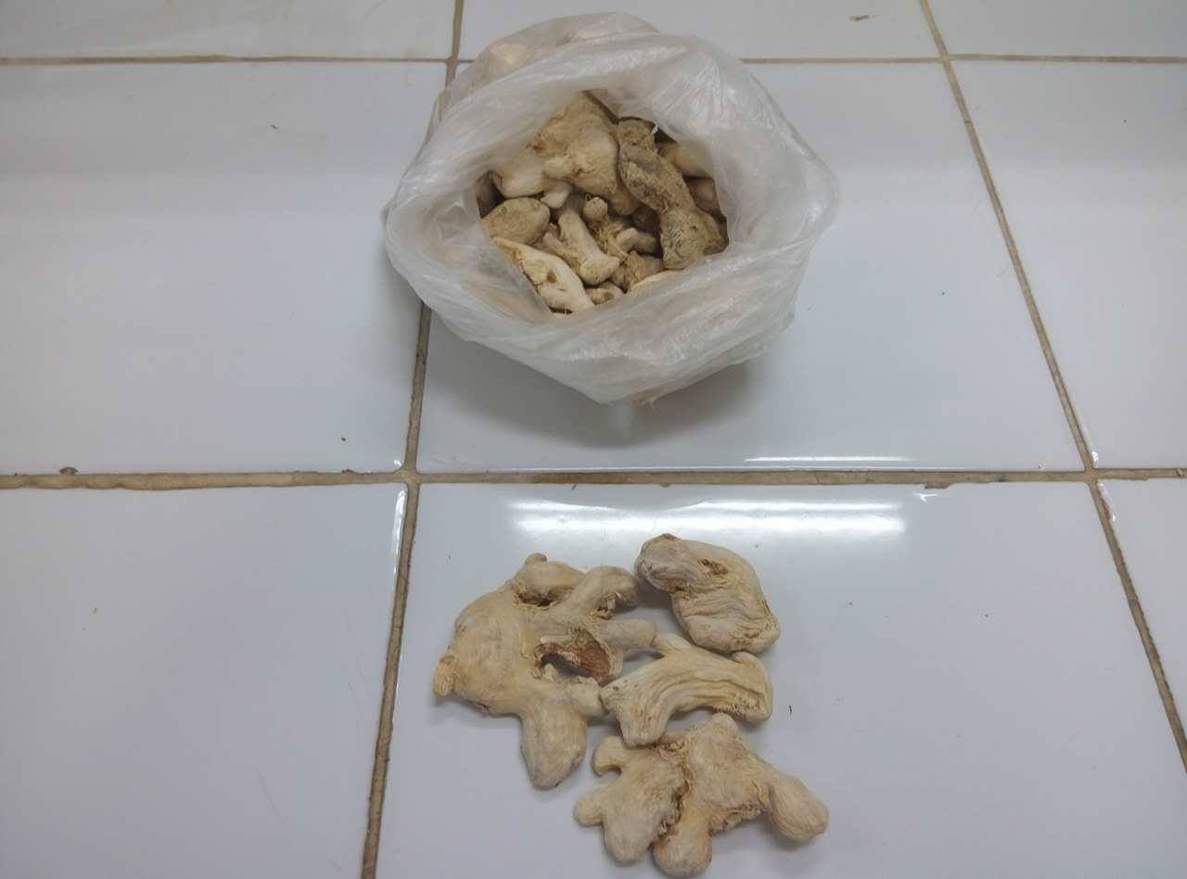
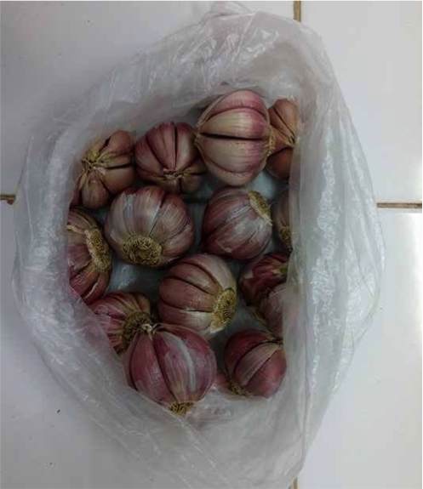
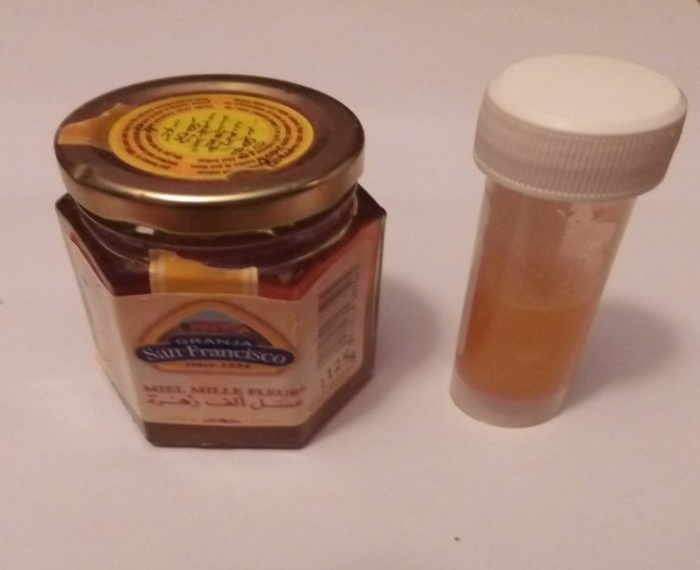
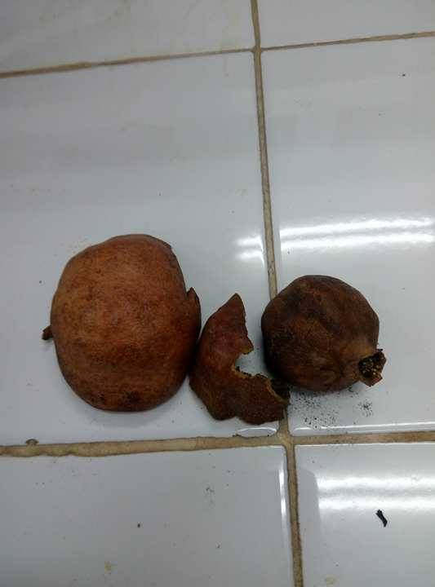
Drugs tested
Ginger
Garlic
Honey
pomegrenate
Notes:
For this we tested some traditional drugs
For Ginger and pomegrenate we prepared hydroalcoholic extracts
For garlic we prepared a methanolic extract
These extracts were lyophilized
Honey we just did dilutions

Slide 17


Effectiveness of extracts on protoscolices
PROTOSCOLICES
SOLUTION TO BE TESTED
Incubation at 37°c
Notes:
in test tubes we mixed 4 drops protoscolices-rich sédiment and 1 ml of solution to be tested

Slide 18
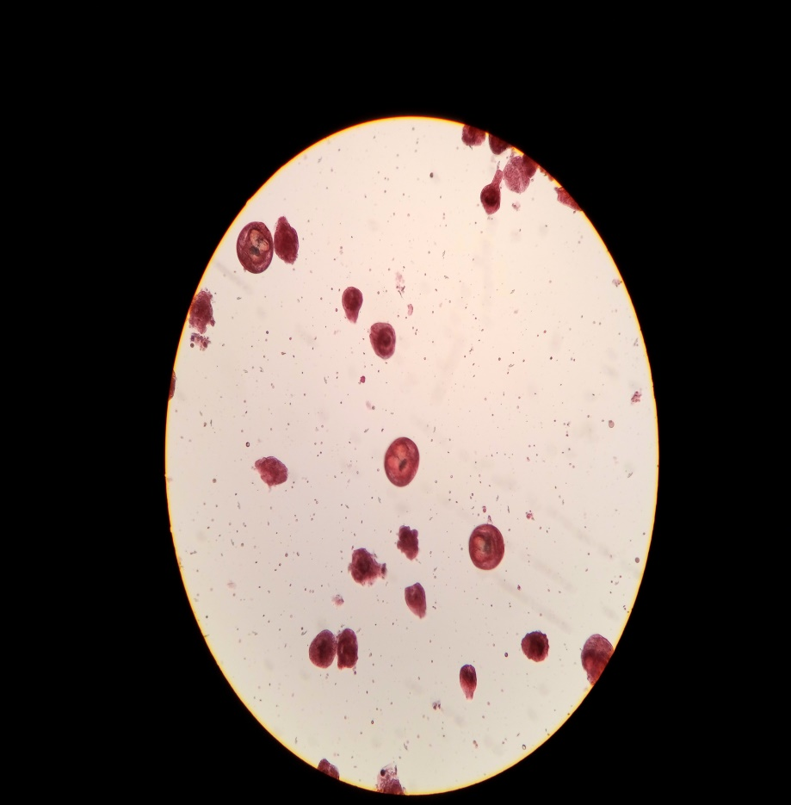
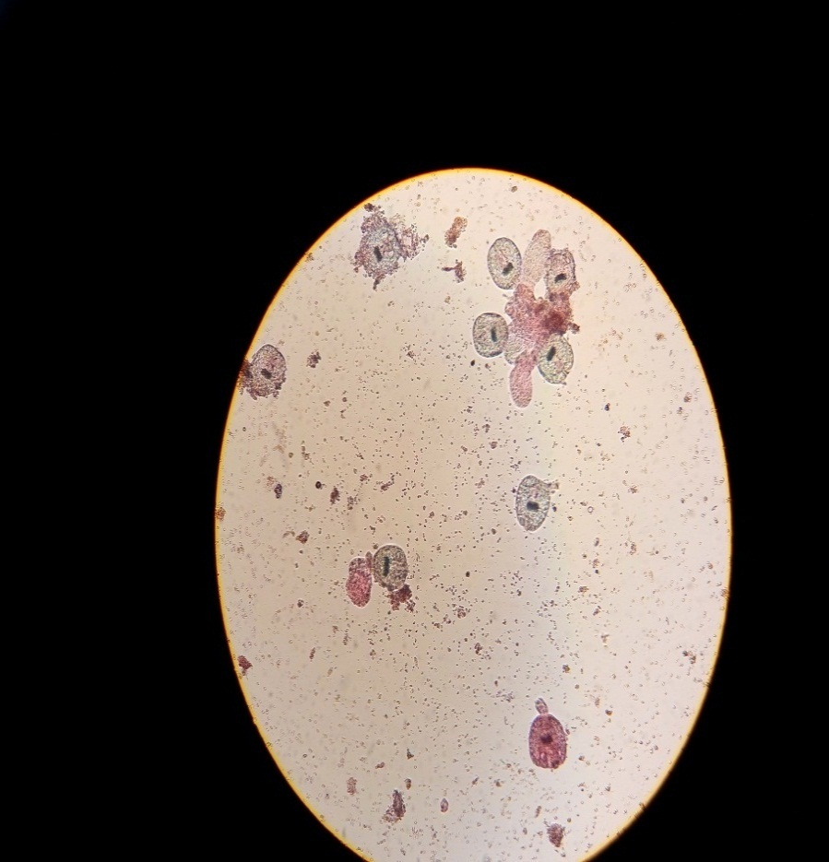
Viability test
Couloured Dead
Incouloured Viable
Notes:
to check the viability of protoscolices after exposure to the extracts, we used the eosin stain 0.1%
The percentages of dead protoscolices were determined by counting a minimum of 250 protoscoleces

Slide 19
Notes:
We had 2 interesting results

Slide 20
pomegrenate
Concentrations | test | % of mortality after exposure
 |  | 10 min | 30 min
10 mg/ml | 1 2 average | 96.1 97.7 96.9 | 95.5 97.1 96.3
30 mg/ml | 1 2 average | 100 100 100 | 100 100 100
50 mg/ml | 1 2 average | 100 99.20 99.6 | 100 100 100
Notes:
percent of mortality was 100 % with 30 and 50 mg/ml concentrations and more then 96% with 10mg/ml concentration

Slide 21
Ginger
Concentrations | Tests | % of mortality after exposure
 |  | 10 min | 30 min
5 mg/ml | 1 2 Average | 100 100 100 | 100 100 100
10 mg/ml | 1 2 Average | 100 100 100 | 100 100 100
30 mg/ml | 1 2 Average | 100 100 100 | 100 100 100
Notes:
we observed 100% of mortality with all concentrations 5 10 30 mg/ml

Slide 22
collaboration skill/resources to promote the project
First study
Molecular analysis
The characterization of the species/genotypes responsible for human hydatidosis in Est of Algeria in order to adapt the measures of control and prevention against this parasitic disease.
Researching a link between the species/genotypes and: the cyst's localization, The fertility rate of cysts, multiple localizations, risk of recurrence, etc.
Notes:
In the first epidemiological study I preserved and stored the hydatid fluid of each cysts for a further molecular analysis

Slide 23
collaboration skill/resources to promote the project
Second study
evaluated the safety of ginger's and pomegrenate's extracts for pharmaceutical purposes as a new scolicidal agent in hydatic surgery .
determined in vivo the efficacy of this extracts using an animal model of hydatid infection.
Identify and isolate the active compounds responsible for the scolicidal effect.
Notes:
The results of this study open the possibility of more investigations like

Slide 24
Difficulties of research in Algeria
The centralization of research facilities and new diagnostic techniques in the capital Algiers.
Lack of funding support to the parasitological projects or to have access to many materials/techniques such as sequencing, animal models, cellular biology,..
Underestimate the great burden of parasitic diseases on public health by the sanitary authorities
Low research collaboration with other countries
Notes:
There is some issues

Slide 25


